Slide 1


Tapestry - Online Learning Journey Meeting
September 2026

Slide 2


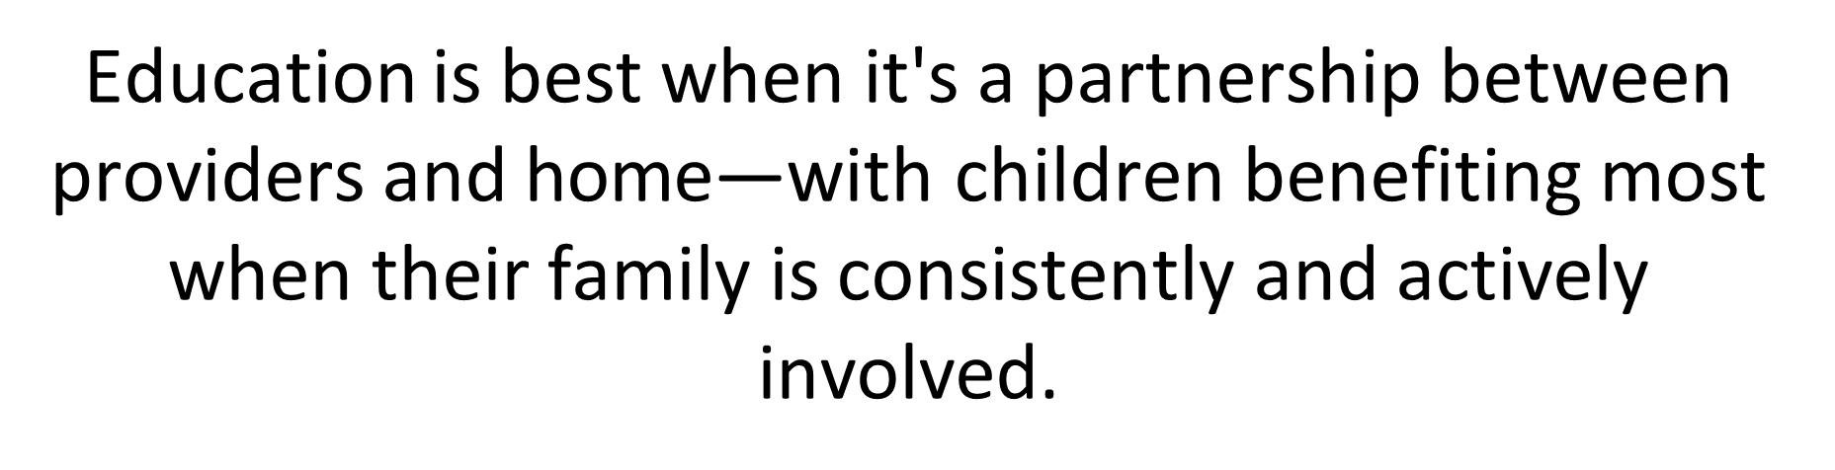
What is Tapestry?
The connection through Tapestry makes it easier for school and home to share each child's learning experiences. By working together it gives children the best chance of fulfilling their potential.

Slide 3
Capturing WOW moments
Our children are: | Our adults:
Resilient Creative Curious Imaginative Determined | Support Praise Encourage Motivate Model Inspire Suggest

Slide 4
Areas of Learning
The Prime Areas
Communication and Language
Physical Development
Personal, Social and Emotional Development
The Specific Areas
Literacy
Mathematics
Understanding the World
Expressive Arts and Design

Slide 5
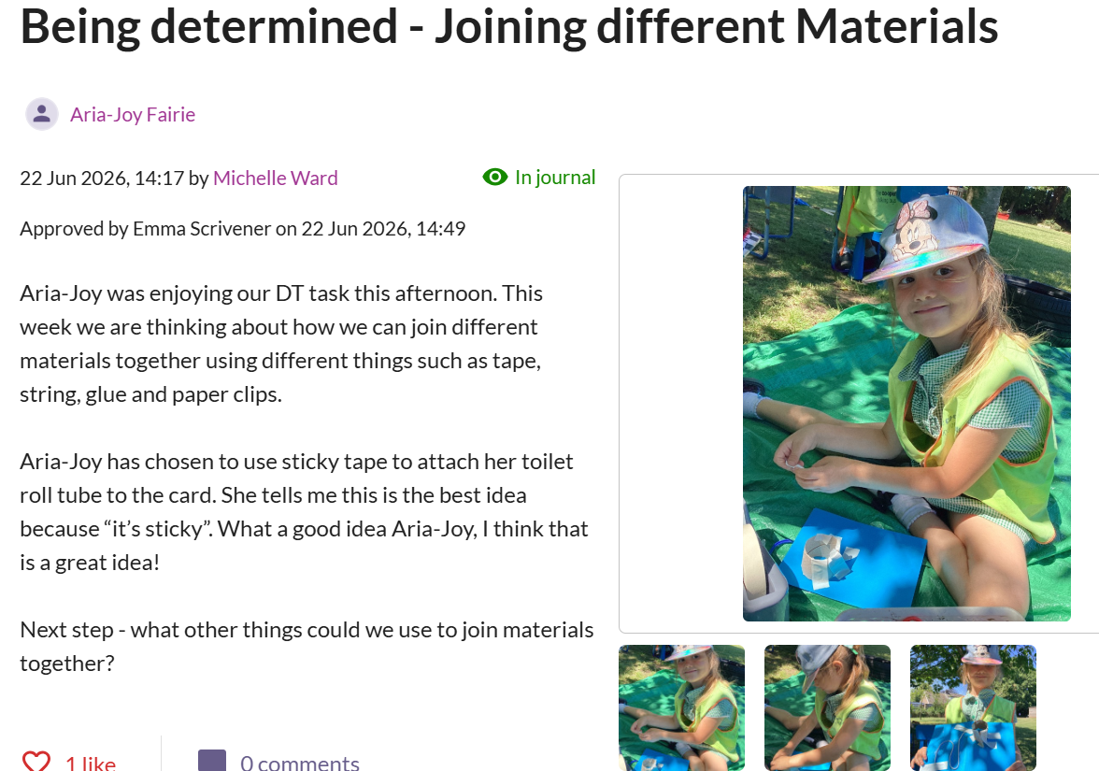
Capturing WOW moments

Slide 6
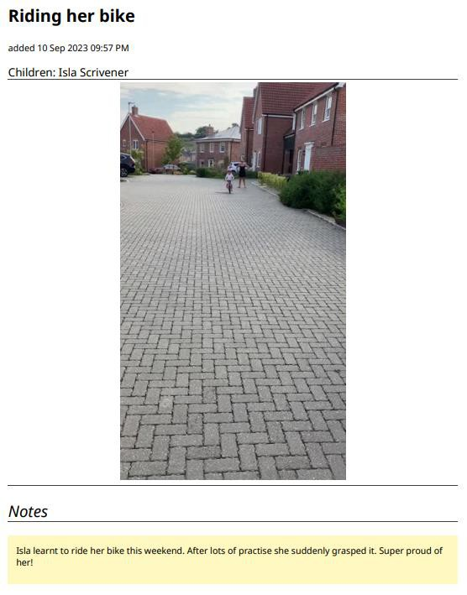
Sharing News
On a Monday at collective worship time, we share any Tapestry news. It is a great speaking and listening opportunity. The children love seeing their photos on the screen to share with their friends!

Slide 7
Focus Children
In Early Years we continually make observations on all children across the curriculum. Each week we will also have a group of 5 focus children from each class. All adults will interact with those focus children even more during their learning and play. We will observe those children during the week in all areas of the environment. These observations will allow us to gain further information on how they are developing and their interests.
Whilst observing the children we will continue to move them on with their learning. All the observations will be on Tapestry so we appreciate any feedback or comments that parents can make via the Tapestry app.
We will also send a questionnaire home the week before your child is to be a 'focus'. By completing and returning this you will help us gain further insights into your child's learning.

Slide 8
Observations
On Tapestry you will receive individual, group and whole class observations of your child. You are able to comment on individual observations but only ‘like’ group observations.
We will send weekly whole class phonics and handwriting Tapestrys where we will inform you of the specific sounds/letter formation we have been focusing on that week. We will give suggestions of words/sentences to follow up with at home to further support your child’s learning.

Slide 9
Next Steps
All of our observations will have a next step on them so that parents are aware of how to move their child’s learning on and how to
support them further at home. These are a suggestion, there is no expectation to follow all of them up.

Slide 10
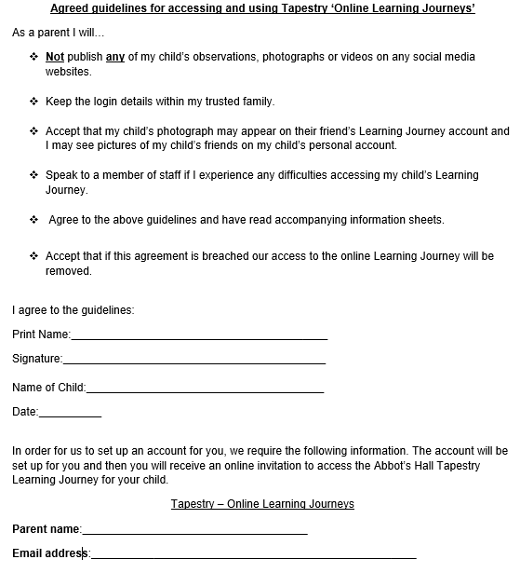
Consent Form

Slide 11
Getting Started…
Return your signed consent form to the school.
Wait for your invitation to join Tapestry to arrive by email. Check your junk emails just in case it goes in there.
Follow the instructions given to activate your account.
Install the app on your mobile device by searching for ‘tapestry journal’ or login on your web browser at https://tapestryjournal.com/
Enjoy receiving emails to say your child’s learning journey has been updated.
Celebrate your child’s achievements!
If you experience any difficulties in using Tapestry then you can find lots of useful tutorials for parents at http://eyfs.info/forums/topic/46927-contents-page/ We will also put a link to this page and other useful Tapestry web links on the Foundation Stage page of our school website at www.abbotshall.suffolk.sch.uk

Slide 12
Final Messages
We continue using Tapestry in Year 1 so you will have access to the app until the end of Phase 1.
Please only use Tapestry as a way of sharing experiences and learning. It is not useful for communicating
important day to day messages.
These can be passed on via the Reading Record, a quick verbal message in the morning to the teachers or most effectively via an email to the school office.
This will ensure that we can act on your message as quickly as possible.

Slide 13
We can’t wait to find out all about what your child is doing at home.
Thank you for listening!

Slide 14


Phonics and Early Reading Information for Parents and Carers
Tuesday 8th September 2026

Slide 15
Why do we teach phonics?
The ability to read and write well is a vital skill for all children, paving the way for an enjoyable and successful school experience.
Phonics helps children to develop good reading and spelling skills.
We are building on the phonics learning your child has begun at pre-school.

Slide 16
How to say the sounds?
Saying the sounds correctly with your child is extremely important
The way we say sounds may well be different from when you were at school
We say the shortest form of the sounds
There is a helpful video on your year group page demonstrating how we teach phonics using our scheme and the correct pronunciation of each single letter sound.
Notes:
Explain and model pure sounds c f h s t

Slide 17
What terminology will my child learn?
Phonemes – These are the sounds in a word e.g. c-a-t
Graphemes – These are the letters that represent each phoneme
Segment/ decode - ‘Chopping up’ the word to spell it out. Identifying the individual sounds in a spoken word (e.g. h-i-m , s-t-or-k) and writing down letters for each sound (phoneme) to form the word ‘him’ and ‘stork’.
Blend - Merging or ‘blending’ the sounds in the order in which they are written to pronounce the word ‘cup’
Tricky words – Words that the children need to learn by sight as they cannot be sounded out e.g. the, come, said
Pseudo/alien words – Nonsense words e.g shrap, blom.
Notes:
Explain and model

Slide 18
How is phonics taught at Abbot’s Hall?
Daily whole class 20 minute sessions taught by the class teacher. Teaching assistants support and extend.
We use the Rocket Phonics scheme and linked reading books which provide a comprehensive system for teaching, applying and embedding phonic skills.
We use the strategy of ‘sound fingers’ to decode and blend words and segmenting for spelling.
Additional phonics interventions are in place to support children who need more support to access and apply their phonics learning.

Slide 19
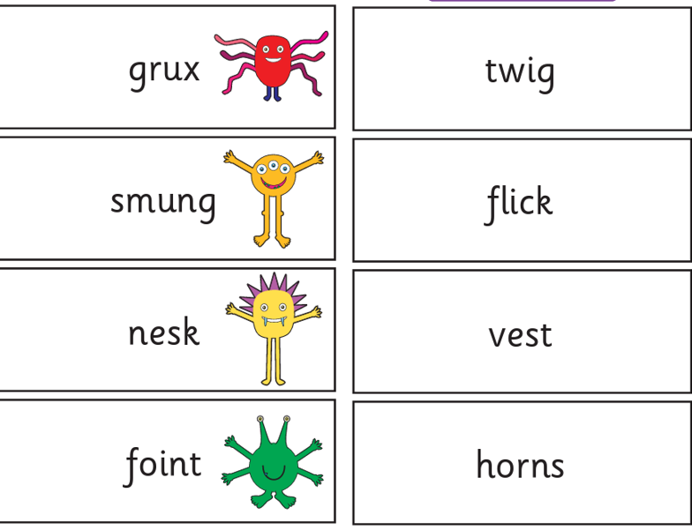
How is my child assessed in phonics?
Phonics assessment after each Rocket Phonics block has been taught (roughly each half term) - testing if the children are able recall the graphemes they have been taught and apply their knowledge to reading and writing words containing these sounds.
Phonics Screening Check
The phonics screening check is taken individually by all children in Year 1 in England in a week in June .
It is designed to give you information on how your child is progressing in phonics.
It will help to identify whether your child needs additional support at this stage so that they do not fall behind in this vital early reading skill.
There will be two sections in this 40-word check and it will assess phonics skills and knowledge learned through Reception and Year 1.
Notes:
The assessment is carried out by your child’s class teacher and they don’t even really know it’s a formal assessment. We carry out practice assessments using previous year’s materials throughout year 1 to track their progress and establish any gaps we may need to fill, as well as to familiarise them with the process so its not a scary thing when we complete the assessment for real.

Slide 20
How can I support my child with phonics at home?
Make time to share their reading book for 10 minutes, every day. Record this in their reading log. Read our ‘next steps’ to see what your child needs to work on when reading at home.
Encourage your child to use ‘sound fingers’ and model this to them when needing support to decode and blend.
Encourage use of their sound mats- we will give you one to take home today
Practise reading and writing high frequency words and common exception words
Play phonics games together
Regularly read different nonsense words
Use the Phonics Play website free resources and games
View the phonics resource tab on our year group website pages
Notes:
Resources mentioned can be found on your year group page on the website and the slides from this presentation will be available to refer to too.

Slide 21
How can I support my child with reading at home?
Read a range of stories, non-fiction, poetry and rhymes to your child. Be a positive role model and read books yourself.
Participate in our school reading challenge.
Encourage your child to be fluent. Reread sentences and model good fluency and expression.
Encourage reading in different environments e.g. restaurants, road signs, shops.
Encourage your child to read unknown words using their phonics, picture clues and the context of the sentence.
Practise reading high frequency words and their sounds.
Join the local library
View the example comprehension questions and sentence stems on our year group website pages to support understanding of reading at home.

Slide 22
How else can I support my child in writing at home?
Support your child with developing a tripod pencil grip – remind them of ‘pinchy fingers’.
Encourage your child to use different writing materials.
Encourage your child to write their name with correct formation.
Encourage your child to write even if they are scribbling to begin with (This is called mark making/emergent writing, the first stage of writing).
Don’t write a sentence for them to copy – unless this is for handwriting practise.
When they are ready, encourage them to use their sound mats to support their writing.
Provide writing opportunities, writing for a purpose is proven to be more engaging for children e.g. shopping list, notes, birthday cards, home learning, diaries.
Be a positive role model and talk about what you are writing.

Slide 23
Thank you for listening
Please feel free to ask any questions and take a phonics pack home with you.

