Slide 1


Tapestry - Online Learning Journey Meeting
September 2025

Slide 2
Education is best when it's a partnership between providers and home—with children benefiting most when their family is consistently and actively involved.
"The Impact of Parental Involvement on Children's Education" ref: DCSF-00924-2008.

Slide 3


What is Tapestry?
The connection through Tapestry makes it easier for school and home to share each child's learning experiences. By working together it gives children the best chance of fulfilling their potential.

Slide 4
Capturing WOW moments
Our school key drivers at Abbot’s Hall: | Our children are: | Our adults:
Aspiration Responsibility Environment ARE you Being The Best That You Can Be? | Resilient Creative Curious Imaginative Determined | Support Praise Encourage Motivate Model Inspire Suggest

Slide 5
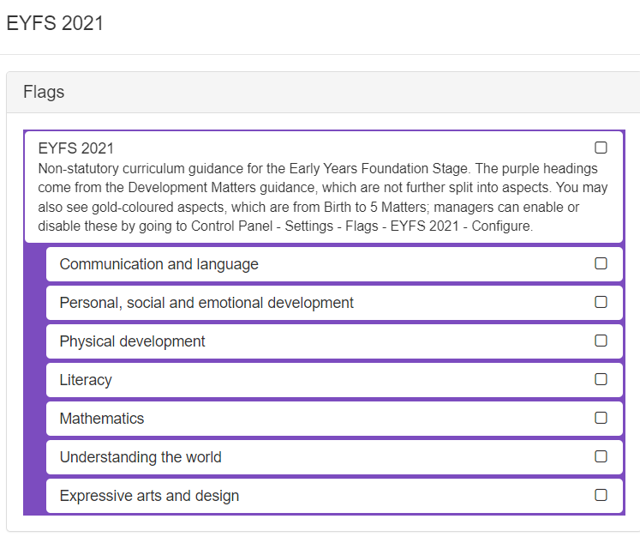
Areas of Learning
The Prime Areas
Communication and Language
Physical Development
Personal, Social and Emotional Development
The Specific Areas
Literacy
Mathematics
Understanding the World
Expressive Arts and Design

Slide 6
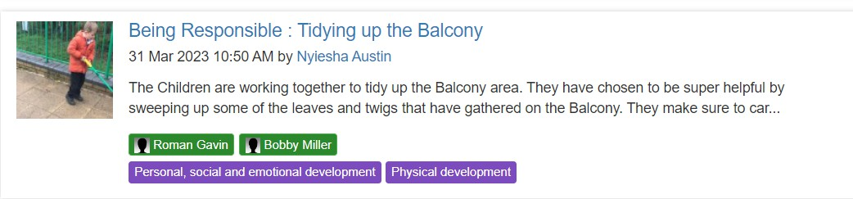
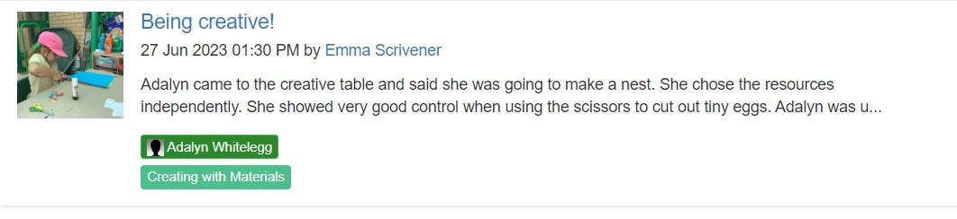


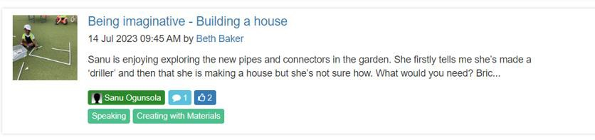
Capturing WOW moments

Slide 7
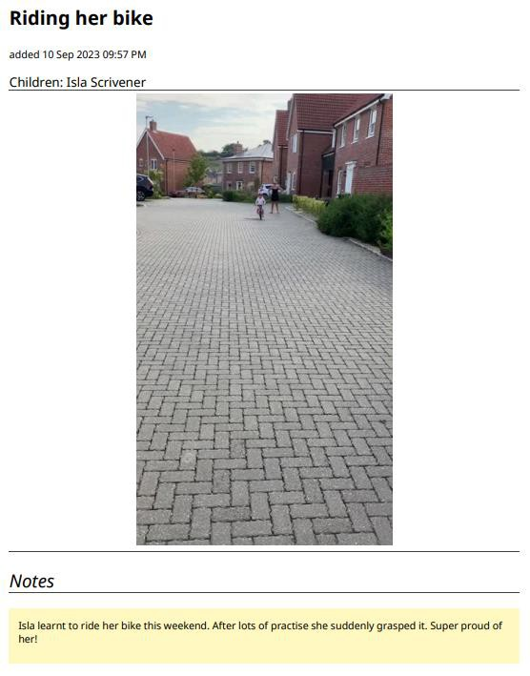
Sharing News
On a Monday at collective worship time, we share any Tapestry news. It is a great speaking and listening opportunity. The children love seeing their photos on the screen to share with their friends!

Slide 8
Focus Children
In Early Years we continually make observations on all children across the curriculum. Each week we will also have a group of 5 focus children from each class. All adults will interact with those focus children even more during their learning and play. We will observe those children during the week in all areas of the environment. These observations will allow us to gain further information on how they are developing and their interests.
Whilst observing the children we will continue to move them on with their learning. All the observations will be on Tapestry so we appreciate any feedback or comments that parents can make via the Tapestry app.
We will also send a questionnaire home the week before your child is to be a 'focus'. By completing and returning this you will help us gain further insights into your child's learning.
If you have any questions then do please ask any of the Foundation Stage teachers.

Slide 9
Observations
On Tapestry you will receive individual, group and whole class observations of your child. You are able to comment on individual observations but only ‘like’ group observations.
We will send weekly whole class phonics and handwriting Tapestrys where we will inform you of the specific sounds/letter formation we have been focusing on that week. We will give suggestions of words/sentences to follow up with at home to further support your child’s learning.

Slide 10
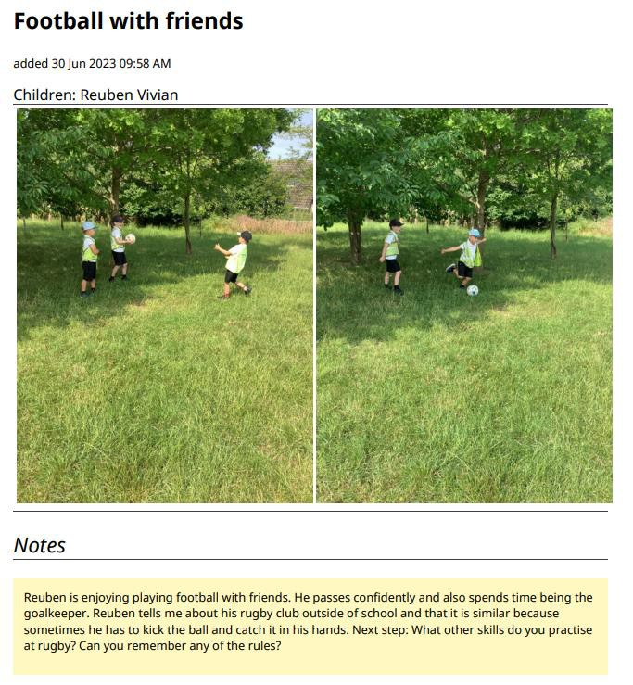
What does it look like to you?

Slide 11
Next Steps
All of our observations will have a next step on them so that parents are aware of how to move their child’s learning on and how to
support them further at home. These are a suggestion, there is no expectation to follow all of them up.

Slide 12
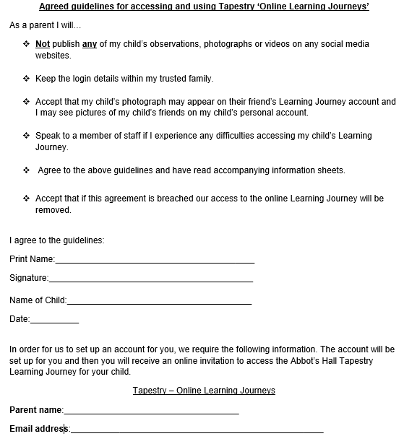
Consent Form

Slide 13
Getting Started…
Return your signed consent form to the school.
Wait for your invitation to join Tapestry to arrive by email. Check your junk emails just in case it goes in there.
Follow the instructions given to activate your account.
Install the app on your mobile device by searching for ‘tapestry journal’ or login on your web browser at https://tapestryjournal.com/
Enjoy receiving emails to say your child’s learning journey has been updated.
Celebrate your child’s achievements!
If you experience any difficulties in using Tapestry then you can find lots of useful tutorials for parents at http://eyfs.info/forums/topic/46927-contents-page/ We will also put a link to this page and other useful Tapestry web links on the Foundation Stage page of our school website at www.abbotshall.suffolk.sch.uk

Slide 14
Final Messages
We continue using Tapestry in Year 1 so you will have access to the app until the end of Phase 1.
Please only use Tapestry as a way of sharing experiences and learning. It is not useful for communicating
important day to day messages.
These can be passed on via the Yellow Reading Record, a quick verbal message in the morning to the teachers or most effectively via an email to the school office.
This will ensure that we can act on your message as quickly as possible.

Slide 15
We can’t wait to find out all about what your child is doing at home.
Thank you for listening!

