Slide 1
Phonics Information for Parents
Parents Information Event – 19th October 2022

Slide 2
What will we cover?
Information about phonics
Ideas of ways to support FS and Year 1 pupils in phonics.
Phonics Screening
Rapid Reading for Year 1
Early Learning Hub

Slide 3
Why do we teach phonics?
The ability to read and write well is a vital skill for all children, paving the way for an enjoyable and successful school experience.
Phonics helps children to develop good reading and spelling skills
We use a scheme called ‘Rocket Phonic’ as our main resource. However we supplement this with many other activities and tasks.
We are building on the phonics learning your child has begun at pre-school

Slide 4
What terminology will my child learn?
Phonemes – These are the sounds in a word sounds e.g c-a-t
Graphemes – These are the letters that represent each phoneme.

Slide 5
How to say the sounds?
Saying the sounds correctly with your child is extremely important
The way we say sound may well be different from when you were at school
We say the shortest form of the sounds
There is a helpful video showing the articulation of all 44 phonemes on YouTube.

Slide 6
What terminology will my child learn?
Segment/ decode
‘Chopping up’ the word to spell it out
Identifying the individual sounds in a spoken word (e.g. h-i-m , s-t-or-k) and writing down letters for each sound (phoneme) to form the word ‘him’ and ‘stork’.
Blend
Merging or ‘blending’ the sounds in the order in which they are written to pronounce the word ‘cup’

Slide 7
What terminology will my child learn?
Tricky words – Words that cannot be sounded out e.g. the, come, said
Pseudo words – Nonsense words e.g shrap, blom.

Slide 8
What are the National Expectations by the end of Foundation Stage - ELG?
Literacy
Comprehension
• Demonstrate understanding of what has been
read to them by retelling stories and narratives
using their own words and recently introduced
vocabulary.
• Anticipate (where appropriate) key events
in stories.
• Use and understand recently introduced
vocabulary during discussions about stories, nonfiction, rhymes and poems and during role play.
Word Reading
• Say a sound for each letter in the alphabet and at
least 10 digraphs.
• Read words consistent with their phonic
knowledge by sound-blending.
• Read aloud simple sentences and books that are
consistent with their phonic knowledge, including
some common exception words.
Writing
• Write recognisable letters, most of which are
correctly formed.
• Spell words by identifying sounds in them and
representing the sounds with a letter or letters.
• Write simple phrases and sentences that can be
read by others

Slide 9
Year 1 (English National Curriculum)
Apply phonic knowledge and skills as the route to decode words
Respond speedily with the correct sound to graphemes (letters or groups of letters) for all 40+ phonemes, including, where applicable, alternative sounds for graphemes
Read accurately by blending sounds in unfamiliar words containing GPCs that have been taught
Spell words containing each of the 40+ phonemes already taught

Slide 10
How is my child assessed on phonics?
Phonics Screening Test
The phonics screening check will be taken individually by all children in Year 1 in England in a week in June .
It is designed to give you information on how your child is progressing in phonics.
It will help to identify whether your child needs additional support at this stage so that they do not fall behind in this vital early reading skill.
There will be two sections in this 40-word check and it will assess phonics skills and knowledge learned through Reception, Year 1
Reception and Year 1 pupils are assessed by class teachers each half term to monitor progress and identify any gaps in knowledge.

Slide 11
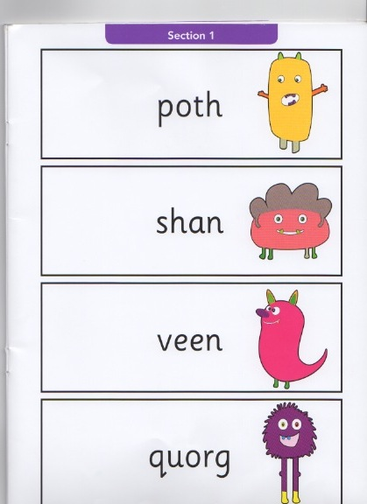
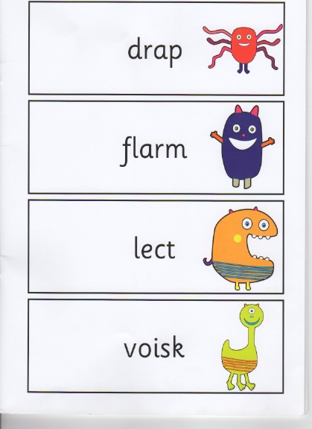

Slide 12
How is phonics taught at Abbot’s Hall?
The Rocket Phonics scheme and linked reading books provide a comprehensive system for teaching, applying and embedding phonic skills
Reading books will be matched to phonic knowledge. These target books should be shared and read many times so that your child is fluent and confident in decoding these sounds before moving on to a new book.
The majority of children are taught phonics in whole class sessions by their class teacher
Teaching Assistants will support and extend small groups of children
20 minutes every day

Slide 13
What is my child learning?
Phase 1 – ( aimed at in pre-school settings but often taught in Reception)
Emphasis on hearing sounds
Learning how to orally segment and blend words e.g. c-a-t
Rhythm, rhyme and alliteration
Notes:
Pre-schools should be teaching this. Some children in Foundation Stage are still working on this.

Slide 14
What is my child learning?
Phase 2 –
Learn 19 simple phonemes (sounds) for some letters (graphemes).
Learn CVC words e.g. mum, cat, dog, tap
Learn some tricky words e.g. the, to, no
Blending sounds together to make words
Segmenting words into their separate sounds
Beginning to read simple captions
Notes:
All Foundation Stage children should be secure in this area by the end of Foundation Stage.

Slide 15
What is my child learning?
Phase 3
Teach more graphemes (mostly made up of 2 letters e.g. oa for boat, ai for rain)
Learn more tricky words e.g. she, you, they
Read and write simple sentences
Reading captions and questions.
Notes:
Many children in foundation Stage should achieve this at the end of this year.
Year 1 – majority of chn will be working on this phase to start with.

Slide 16
What is my child learning?
Phase 4
Recap of phase 2 and 3.
Practise segmenting and blending.
Phase 5
Learning that sounds can be spelled in more than one way e.g f, ff, ph
Learn that letters can make more than one sound e.g. leaf and bread
Notes:
Children will need to be secure in all phases to achieve in the phonics screening.

Slide 17
How can I support my child with phonics at home?
Make time to share their reading book for 10 minutes, every day
Encourage use of their sound mats
Practise reading and writing high frequency words ( inside yellow home/school book)
Play phoneme games together.
Regularly read different nonsense words
Use the phonics play website.
View our phonics videos on our website.
See Phonics Family on Facebook or Instagram

Slide 18
How else can I support my child in reading at home?
Read a range of stories, non-fiction, poetry and rhymes to your child. Be a positive role model and read books yourself.
Listen to your child read regularly and tell us about it using the yellow home/school book.
Encourage your child to be fluent. Reread sentences and model good fluency and expression.
Encourage reading in different environments e.g. restaurants, road signs, shops.
Encourage your child to read unknown words using their phonics, picture clues and the context of the sentence.
Practise reading high frequency words and their sounds.
Join the local library
Talk about books
What might happen next?
What did he do that?
Do you like the book?
What has happened so far?

Slide 19
What is Rapid Reading for Yr 1?
Daily reading session for 20 mins.
Taught in blocks of 2 weeks, at different times in the year.
Using expertise from across the school.
Each group will work with the same adult for the whole block.
Class Teachers and English Leaders will plan the sessions.
Staff will feedback to class teachers daily.

Slide 20
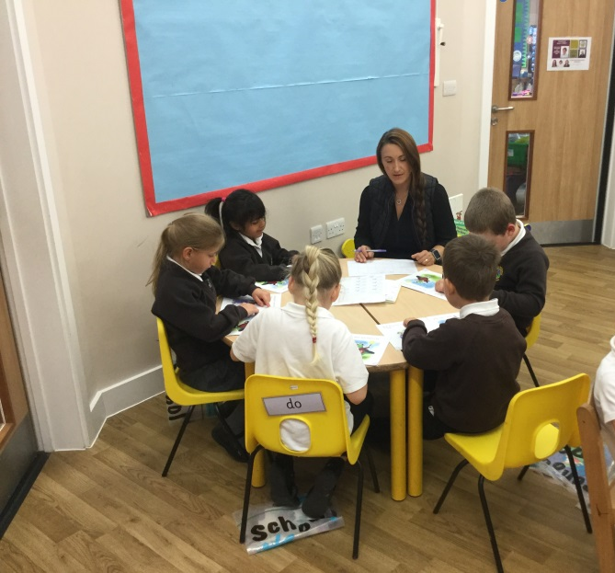
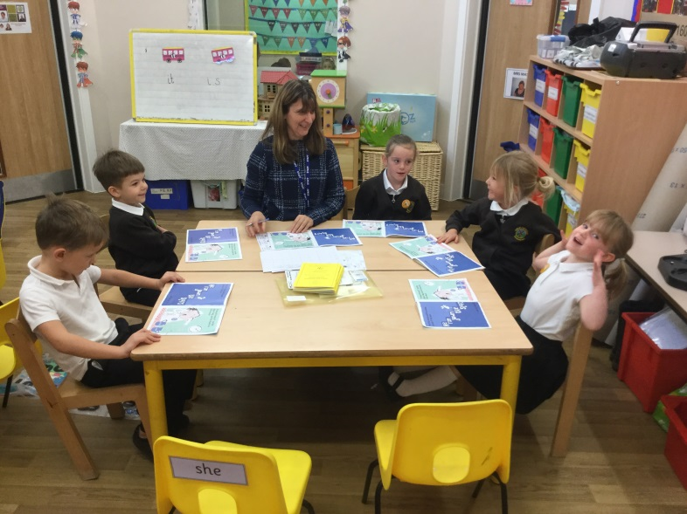
What will happen in these sessions?
Sessions will focus on building fluency.
Pupils will read 2 different books across the week.
They will discuss and answer questions throughout the sessions.
Strategies will be used to help improve children’s reading.
Friday will focus on reading of high frequency words.
A sticker will be put in the pupils’ logs to show that they have participated in a ‘Rapid Reading’ session.

Slide 21
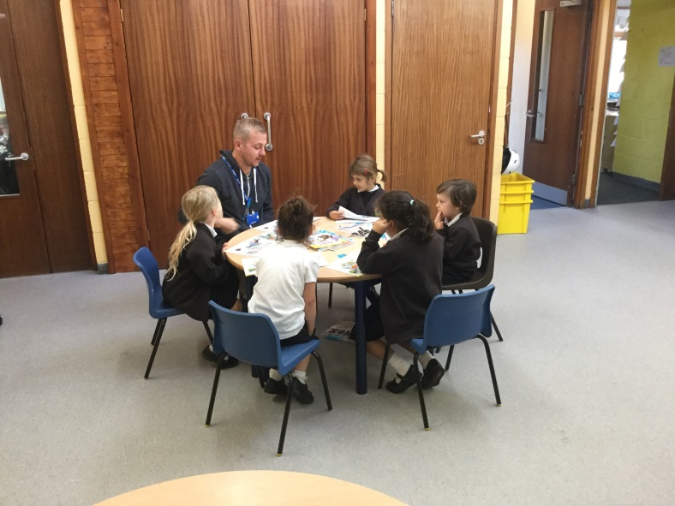
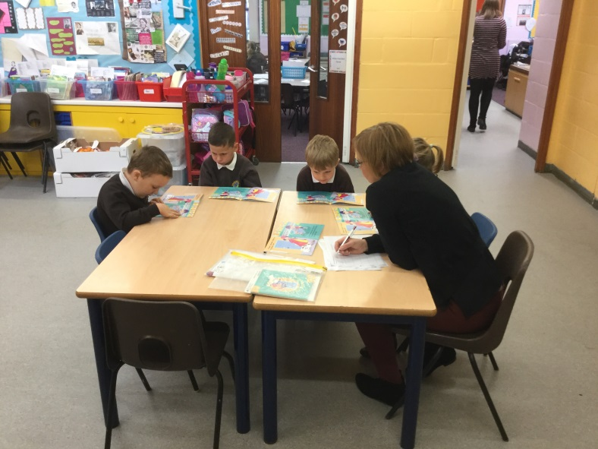
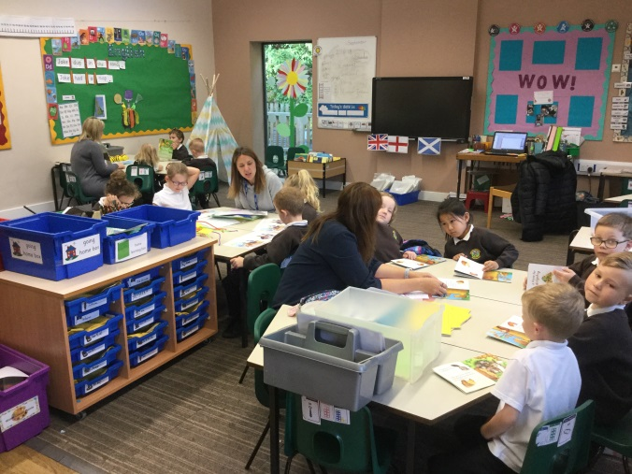
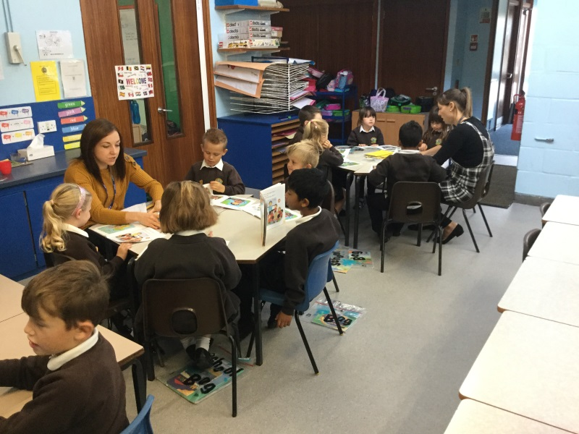
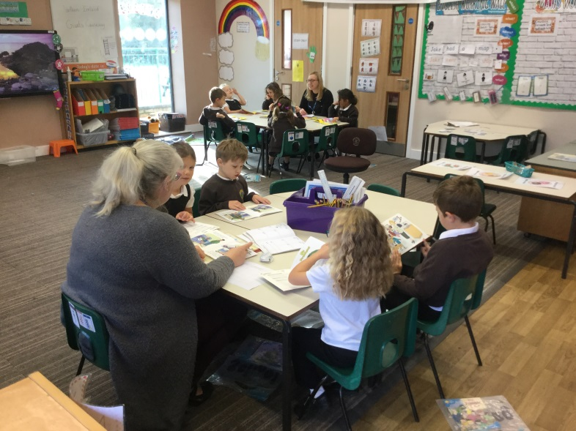
Rapid Reading in Action

Slide 22
How else can I support my child in writing at home?
Encourage your child to use writing materials.
Encourage your child to write their name using their phonics.
Encourage your child to write even if they are scribbling to begin with (This is called emergent writing, the first stage of writing).
Don’t write a sentence for them to copy – unless this is for handwriting practise.
When they are ready encourage them to use their sound mats to support their writing.
Provide writing opportunities e.g. shopping list, notes, birthday cards, home learning, diaries.
Be a positive role model and talk about what you are writing.

Slide 23
You can make a difference
Here’s how many words children would have heard by the time they were 5 years old: Never read to, 4,662 words
1–2 times per week, 63,570 words
3–5 times per week, 169,520 words
daily, 296,660 words
five books a day, 1,483,300 words
( DfE The reading framework - teaching the foundations of literacy)

Slide 24
Early Learning Hub
The Early Learning Hub is open every Monday 2.15 to 2.45pm in the North Hall.
Drop-in sessions for parents and carers of children in Foundation Stage and Year 1
Borrow a game to support your child’s learning
Staff available to chat about any help or ideas that that you might need to support your child
Tea and coffee!
Thank you for listening.
Please ask any questions and complete the feedback sheet.

