Slide 1
Meet the Teacher
Phase 3
Year 6
Monday 1st July 2024
Tuesday 2nd July 2024
Notes:
1

Slide 2
Phase 3 Team
Year 4 Teachers: Mrs Curtis and Mrs Vaughn
TA support: Mrs Filby, Mrs Croft
Year 5 Teachers: Mrs Childs and Miss Holmes
TA support: Miss Scott and Mrs Anderson
Year 6 Teachers: Miss Edwards-Mrs Scarfe (Assistant Head and Phase 2 Leader),
Miss Woodage-Mrs Rolph and Mr Aldred (Interim Deputy Head and Phase 3 Leader)
TA support: Mrs Aldous, Mrs Manser
Phase 3 leader: Mr Aldred
Pupil Support Officer (Behaviour and Attendance): Miss Laws
Notes:
2

Slide 3
Any messages – please write in the Yellow Log books or speak to someone in office.
If you wish to discuss anything about progress or anything else regarding your child in school, please make an appointment with your class teacher at any time in the school year.
You may also make appointments with Mr Aldred, Mrs Scarfe or Mr Pettitt if necessary.
Notes:
3
Children will receive new Yellow Logs at the start of each term. Appointments can be made by speaking to class teachers or ringing the school office.

Slide 4
Attendance
Please phone by 10am on morning of absence – the office will contact you if a reason for absence if not provided.
Doors open 8.40am
Register taken 8.45am
Arrival between 8.45 – 8.55am marked as LATE. Letters will be issued for repeated lateness.
Arrival after 8.55am – sign in at office – Unauthorised absence
6 OR MORE sessions (3 days) may incur a fine from county. Please fill out an absence request form and you will be informed whether or not the absence is authorised
Letters and referral to the Education Welfare Officer may be issued for repeated absence (weekly attendance checks are carried out across school)
Notes:
4
Remind parents to fill in absence request forms for any term time trips or holidays – they may incur fines for these but speak to Mr Pettitt if they have any questions.

Slide 5
Breakdown of the day…
Break times will be 10:25-10:40am each day.
Phase 3 lunchtime is 12:10-1:10pm.
There is usually no afternoon playtime but we will do a ‘daily mile’ to keep children active.
Collective Worship will take place each day either in the hall or in classrooms.
Notes:
Collective Worship may be whole school assemblies, visiting speakers, House Team assemblies, Proud assemblies or Key Stage/class assemblies.
5

Slide 6
Collection & Drop-off
Year 4 – Blue zone door
Year 5 – Green zone door
Year 6 – Green zone door
3.15pm at the doors above – please let the office know if you may be late
Year 5 and 6 are allowed to walk independently to and from school WITH WRITTEN PERMISSION. This is subject to the children being responsible when walking on their own.
Notes:
Teachers will bring children out to the playground to meet you.
6

Slide 7
Collection
A note or phone call is ESSENTIAL if your child is being collected by a different person. They will not be allowed to go if we don’t know about it! If regular sharing, let us know at the start of the term on the permission form.
We encourage families to get a car park pass for Iliffe Way to reduce the number of cars on Danescourt Avenue.
Please remember to park respectfully and try to avoid walking across the staff car park for safety reasons.
Notes:
7
Walking Bus – meets at the Museum of East Anglian Life at 8:25 and children are walked to school by a member of staff and parent helpers. Children can then be collected from the same place at approx. 3:30pm. Parents can ask for car park passes for Iliffe Way (near the ASDA car park) to park for FREE to meet their children.
They can also get museum passes to walk through the museum themselves.

Slide 8
Curriculum
All classes in Phase 3 will be working from the National Curriculum.
Please see the website for all curriculum overviews in September.
More detailed Curriculum Information Sheets will be sent out in the first couple of weeks of each term to give a more in-depth overview of the term’s learning.
Notes:
Other things to mention: We use ‘Penpals’ handwriting scheme, Twinkl spelling scheme, White Rose Maths Mastery. More information can be found on the website.
8

Slide 9
Year 6 Topics
Autumn Term- Blue Planet
Spring Term- World War Two
Summer Term- Moving Earth
Notes:
9

Slide 10
Office Items
Photographs: Please update your photo permissions on the form provided in early September
Contact details: are your numbers correct?
Dinner money: pay via Arbor
Medicine – ALL must be signed in at the Office (even skin creams/cough sweets!)
The Office is staffed from 8.00am and is open from 8.30am
Notes:
10
Forms will be sent home early Sept. for parents to give up to date photo permission and contact details.

Slide 11
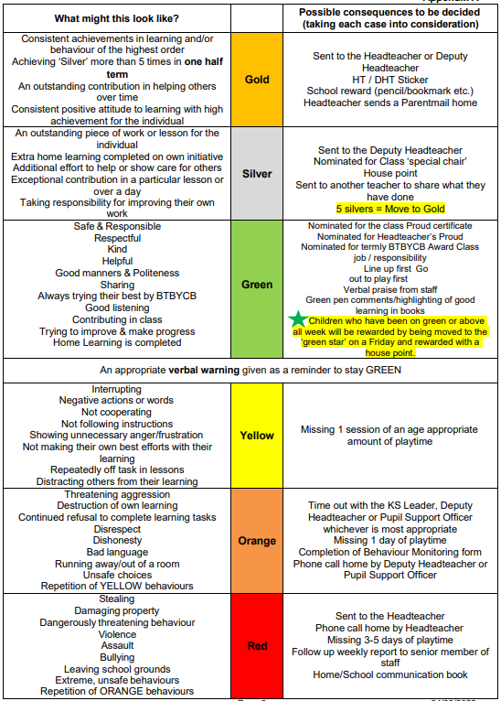
Behaviour Ladders
Structure, sanctions and rewards are the same across the whole school.
Children should be ‘Green’ – demonstrating behaviours that are expected at all times.
Children behaving ‘above and beyond’ expectation will be rewarded as shown in the ‘Silver’ and ‘Gold’ sections of the ladder.
Those children consistently on ‘Green’ all week will move to the shooting star to receive a house point
Negative behaviours will have consequences as outlined on the behaviour ladder, in line with the type of behaviour and the age of the child.
Some children may still have individual behaviour plans in addition to our whole school policy.
Notes:
11
Note that some pupils have individual behavior support plans.

Slide 12
Uniform
Pupils should be wearing the correct uniform for school at all times (unless there is a valid reason that has been shared with the class teacher by an adult).
All children need to wear shoes and not black trainers.
Pupils should not be wearing nail varnish or make-up for school.
PE KIT:
NAMED Kit (in a small sports bag) – black shorts, white t-shirt, dark coloured tracksuit and trainers. Trainers for outdoor games must be worn.
New for September 2024: Pupils can come to school wearing their PE kit on their PE days.
Notes:
12

Slide 13
Food and Drink
Morning snack – fresh or dried fruit or vegetable – NO cereal bars, fruit bars, fruit flakes, fruit winders etc.
NUT AND SEED FREE
NAMED water bottle – sports cap is best to avoid spillages.
Notes:
13

Slide 14
Home Learning
Reading as often as possible with an adult signing the Yellow Log
Spellings sent out each term but these are not tested.
TTRS – password will be put on home-school log
Time to Talk (Spring Term)
New Home Learning grids will be sent home for each topic at the start of each term and will be available on the school website. Children can choose one or more pieces to complete each week but must hand in something each Friday. Any help or resources required, please see your child’s class teacher.
There will be a weekly lunchtime homework club if this is helpful.
Home learning will not be required on the first Friday after a holiday.
Children will be given one pass each term and then will receive a detention, at lunch time, if no home learning is handed in.
Children will then need to provide the missing piece of home learning on the following Monday.
Notes:
14
Full instructions will be on the grids for home learning. If you wish, children can be extended by completing additional tasks. Please remember to complete home learning on a suitably sized piece of paper with a pencil or black handwriting pen to ensure skills are being practiced as in school. Awards are often given for good quality home learning.

Slide 15
Trips and Visits
We aim to have a trip or visiting group once a term – we will give as much notice for this as we can.
Autumn – Hilltop; Anglian Water
Spring – Duxford
Summer – Crucial Crew
Notes:
15

Slide 16
100 experiences
We have introduced 100 experiences before you leave Abbot’s Hall this year.
Pupils have a booklet and we will ensure they have the opportunity to do all these experiences before they leave!
Notes:
16

Slide 17
Questions?
Notes:
17

