Slide 1
Suffolk County Music Service Presents:
Ode to
Joy
Composed by Ludwig van Beethoven
(arranged by Lucy Pankhurst and adapted from Puzzle Pieces)

Slide 2
Let’s Perform!
Let’s learn the structure for the whole song and then perform all together!
Introduction
Section A
Section B
Section C
Ending

Slide 3
Section A
OR

Slide 5
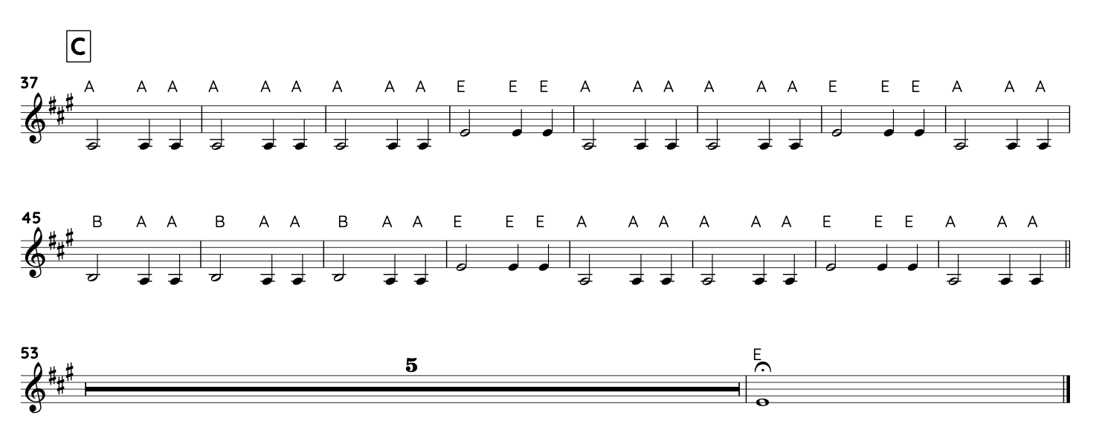
Section C

